Slide 1
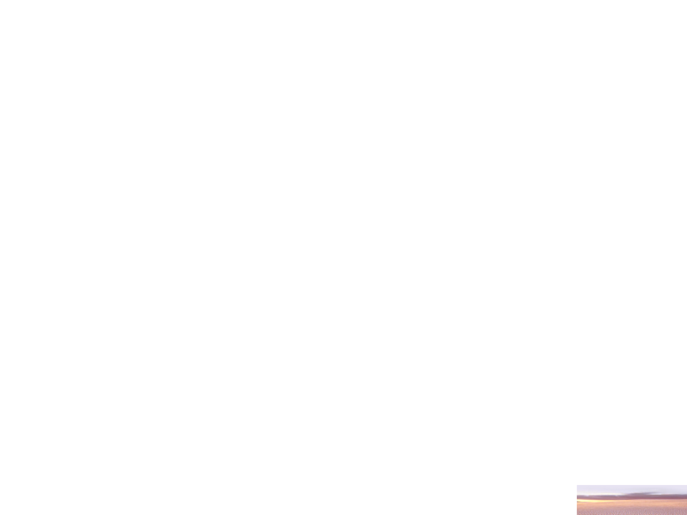
COMPE / SE / ISE 431
Operating Systems
2013 Fall
Erhan GÖKÇAY (Coor.) Department of Software Engineering
Murat KARAKAYA Department of Computer Engineering

Slide 2
INSTRUCTORS
Name | Erhan Gökçay | Murat Karakaya | Teaching Assistant
E-Mail | egokcay@atilim.edu.tr | kmkarakaya@atilim.edu.tr | TBD
Office | A-13 | Z-14 | TBD
Office Hour | Monday 16:30-17:20 | Wed 14:00-14:30 | TBD

Slide 3
2013-2014 FALL SEMESTER |  |  |  |  | COMPE 431
 | Monday | Tuesday | Wednesday | Thursday | Friday
08:30 - 9:20
09:30 - 10:20 |  | (EG) COMPE 431-01 B-1012 | (KMK) COMPE 431-03 B-1037
10:30 - 11:20 |  | (EG) COMPE 431-01 B-1012 | (KMK) COMPE 431-03 B-1037
11:30 - 12:20 | (EG) COMPE 431-01 1019 |  | COMPE 431-LAB 1 | COMPE 431-LAB 2 | COMPE 431-LAB 4 (cont. Next hour!)
12:30 - 13:20 | (EG) COMPE 431-02 1019 |  | COMPE 431-LAB 1 | COMPE 431-LAB 2 | (KMK) COMPE 431-03 B-1033
13:30 - 14:20 |  | (EG) COMPE 431-02 B-1012
14:30 - 15:20 |  | (EG) COMPE 431-02 B-1012 |  | COMPE 431-LAB 3
15:30 - 16:20 |  |  |  | COMPE 431-LAB 3
16:30 - 17:20
17:30 - 18:00

Slide 4
PREQUISITE COURSES
  None

Slide 5
Objectives & Content
    To teach fundamental issues of operating systems such as
      processes,
      threads,
      scheduling,
      synchronization and deadlocks,
      managing resources..

Slide 6
Objectives & Content
    Basic design principles of operating systems.
    Single-user systems, Command interpreter.
    Semaphores, Deadlock detection, recovery, prevention and avoidance.
    Multi-user OS.
    Different resource managers,
    Processor management and algorithms,
    Memory management: Partitioning, paging, segmentation and thrashing.
    Device management. Interrupt handlers, Device drivers and controllers.
    Management of secondary storage.
    File handling.
    Data and program security and protection.
    Basic concepts of distributed systems.

Slide 7
Text Books and References
  Course Book:
  1. Silberschatz, Galvin, and Gagne, Operating System Concepts, 7th Edition, John Wiley and Sons, 2005.
  Other Sources:
  Andrew S., Modern Operating Systems, Tanenbaum, 2nd edition, Prentice-Hall, 2001.
  Gary Nutt, Operating Systems, Addison-Wesley, 2004.
  Stallings, Operating Systems: Internals and Design Principles, 6/e, Prentice Hall.

Slide 8
Grading
(Tentative)
  Lab 10%
  Project 15%
  2 Midterms 40%
  Final Exam 35%
  Attendance required!
  DD >= 40 FD<=39

Slide 9
Grading Policies
  Missed exams:
    no make-up exam for midterms without approved excuse!
    no make-up exam for final for any excuse!
  Ethics:
    All assignments/projects are to be your own work.
  Participation:
    You are supposed to be active in the class by involving and participating disscusions via
      asking questions,
      proposing solutions,
      explaning your ideas, etc.

Slide 10
WEEKLY SCHEDULE AND PRE-STUDY PAGES
1. Week | Introduction to OS | Ch.1,2
2. Week | OS Structures, Processes | Ch.2
3. Week | Processes | Ch.3
4. Week | Threads | Ch.4
5. Week | Scheduling | Ch.5
6. Week | Scheduling | Ch.5
7. Week | Process Synchronization | Ch.6
8. Week | Process Synchronization | Ch.6
9. Week | Deadlocks | Ch.7
10. Week | Deadlocks | Ch.7
11. Week | Memory Management | Ch.8
12. Week | Virtual Memory | Ch.9
13. Week | File Systems | Ch.10-11
14. Week | I/O System | Ch.13
15. Week | Final Exam
16. Week | Final Exam

Slide 11
EXPECTED WORK LOAD
  Need to have a copy of the Text Book
  You have to read the chapters in the book.
  You have to take note during the class & lab.
  You have to be active in the labs.
  Thus, your presence during all the classes is important.

Slide 12
LAB Sections
  There are 4 Lab Sections:
    Wednesday 11.30-13.20 OP.SY.LAB
    Thursday 11.30-13.20 OP.SY.LAB
    Thursday 14.30-16.20 OP.SY.LAB
    Friday 11.30-13.20 OP.SY.LAB
  If you have any courses conflicting with any Lab sections, please bring your approved form for the conflicting hour signed by the Class Instructor
  Otherwise, all students are randomly distributed to the 4 Lab sections.

Slide 13
COMPE 431 OS
IMPORTANT REMINDER
    I will be out of campus next week (23-27 Sept. 2013)
    Therefore, you are kindly requested to attend any of the two sections given by Erhan Hoca (see below).
    Note: The attendance will be taken by Erhan Hoca!
2013-2014 FALL SEMESTER
 | Monday | Tuesday
09:30 - 10:20 |  | (EG) COMPE 431-01 B-1012
10:30 - 11:20 |  | (EG) COMPE 431-01 B-1012
11:30 - 12:20 | (EG) COMPE 431-01 1019
12:30 - 13:20 | (EG) COMPE 431-02 1019
13:30 - 14:20 |  | (EG) COMPE 431-02 B-1012
14:30 - 15:20 |  | (EG) COMPE 431-02 B-1012

Slide 14
Any Questions?

